Slide 1
Index 360
Looking at Indexes from Multiple Perspectives
May 10, 2017

Slide 2
Who is this guy?
…and why listen to him?
John Eisbrener
@johnedba john@dbatlas.com
DBA: Default Blame Assignee/Acceptor
DBA for over 10 years
MSSQL, Oracle, Greenplum, Postgres
Owner/Principal Consultant of a boutique consulting firm, DB Atlas
http://www.dbatlas.com
I have the microphone

Slide 3
Agenda
Index Basics
Index Advanced Topics
Index Design Considerations
Index Misconceptions
Additional Resources
Supplemental Queries
Questions

Slide 4
Index Basics – Section Overview
What is an index?
Difference between Rowstore and Columnstore Indexes
B+ Trees
Heap Tables vs. Clustered Tables
Clustered Index vs. Nonclustered Index (Rowstore)
Primary Key vs. Clustered Key
Covering Index
Clustered Index vs. Noncluster Index (Columnstore)
Trivia

Slide 5
What is an Index?
Structure that contains data or pointers to data
Designed in such a way as to search for data efficiently
Designed to perform to scale as a database grows in size
The type of index determines how data is stored on disk
Highly customizable
Columnstore indexes were introduced in SQL Server 2012
https://technet.microsoft.com/en-us/library/jj835095(v=sql.110).aspx

Slide 6
Difference between Rowstore and Columnstore Indexes
Rowstore
Columnstore
Stored in a row-wise format mimicking table definition
Compression is optional and can be either Page or Row-based
Pulls all columns defined within Index
Optimal for Transactional /Normalized workloads
Takes advantage of Batch Mode Processing with a Dummy NCCI
Stored in a column-wise format via Rowgroups
Compression required, and can be default or Archive (slow)
Pulls only columns needed by query
Optimal for Analytical /Denormalized workloads
Takes advantage of Batch Mode Processing w/o a hack
https://docs.microsoft.com/en-us/sql/relational-databases/indexes/columnstore-indexes-overview http://sqlmag.com/sql-server/what-you-need-know-about-batch-mode-window-aggregate-operator-sql-server-2016-part-1

Slide 7
Difference between Rowstore and Columnstore Indexes (continued)
SELECT Col01, Col02
FROM Table
Row-Wise Storage: Full Table Pulled
Column-Wise Storage: Only Col01 & Col02 Pulled

Slide 8
B+ Trees
Variant of a B Tree, also known as a Balanced Tree
Only Leaf Level Contains Data or Pointers to Data
Designed to be very shallow and very wide
Highly Scalable and Performant
Only used for Rowstore Indexes or Delta Rowgroups
https://en.wikipedia.org/wiki/B%2B_tree

Slide 9
B+ Trees (cont’d)
https://en.wikipedia.org/wiki/B%2B_tree#/media/File:Bplustree.png

Slide 10
Heap Table vs. Clustered Table
Heap Table
Clustered Table
Data is ordered implicitly by the order it was inserted
Quick for Inserts
Consumes more space when not truncated/reloaded/rebuilt
Best for staging tables
Data is ordered explicitly as defined by the clustered key
Quick for Selects, Updates, and Deletes
Reuses empty space efficiently
Best for transactional tables
https://technet.microsoft.com/en-us/library/cc917672.aspx

Slide 11
Clustered vs. Nonclustered Index
Clustered Index
Nonclustered Index
Clustered Key defines the order of the data within the table
Data is stored at the leaf level of the index
Index is the data
Can enforce Uniqueness
Does not require a Primary Key
Index Key defines order of data within the index
Pointers to the data are stored at the leaf level of the index
Index is a copy of the data
Can enforce Uniqueness
Does not require a Primary Key
https://docs.microsoft.com/en-us/sql/relational-databases/indexes/clustered-and-nonclustered-indexes-described

Slide 12
Primary Key vs. Clustered Key
Primary Key
Clustered Key
One per table
Can be defined for any Index
Can be multiple columns
Must Uniquely Identify a single record
Used for Referential Integrity (RI) / FKEY relationships
Determines data order only if it is also the Clustered Key
One per table
Can be defined for any Index
Can be multiple columns
Does not need to uniquely define a single record
Unless defined as a PKEY or UNIQUE cannot be used for RI
Always Determines Sort Order of Data within the table
https://docs.microsoft.com/en-us/sql/relational-databases/indexes/clustered-and-nonclustered-indexes-described

Slide 13
Covering Index
Contains all Columns referenced in a Query
Nonclustered Indexes
Will avoid row-identifier (RID) lookups against the heap or clustered table
INCLUDE Keyword Optionally Used For Columns Not in the Predicate
Contains a Copy of column(s) in addition to the Index Key
Reduces Disk I/O
Smaller/Narrower than Clustered Index
https://docs.microsoft.com/en-us/sql/relational-databases/indexes/create-indexes-with-included-columns

Slide 14
Covering Index (continued)
SELECT Col08 FROM TableA WHERE Col02 = 5 AND Col17 = 99
CREATE NONCLUSTERED INDEX [IX_TableA_Alpha] ON [dbo].[TableA]
( Col02, Col17, Col22 )
INCLUDE
( Col08, Col09, Col18 )
( Col02, Col17, Col08)
( Col02, Col17)
INCLUDE
( Col08 )
SELECT Col08, Col09, Col17, Col18
FROM TableA
WHERE Col02 = 5
AND Col17 = 98
AND Col22 < 5

Slide 15
Clustered Index vs. Noncluster Index (Columnstore)
Clustered Columstore Index (CCI)
Nonclustered Columnstore Index (NCCI)
One Per Table
Converts table data to column-wise storage format
Significant Table Compression
Use for Analytical Workloads such as Fact Tables
Uses a Delta Rowgroup
Cannot define a filter
One Per Table
Sits on top of Heap or Clustered (Rowstore) Index
Copy of Data; uses more space
Used for Hybrid Transactional /Analytical Processing (HTAP)
Uses a Delta Rowgroup (2016+)
Can define a filter
https://blogs.sentryone.com/melissacoates/overview-columnstore-indexes-sql-server/

Slide 16
Trivia Time – Which Index is Faster?
Table containing 10 columns (Col01 – Col10)
Clustered Index with Primary Key defined on Col01
Nonclustered Index defined on Col01 and Col02
Columns Col03 and Col04 are INCLUDEd
Table contains 21.7 Million Records
Execute Query
SELECT Col03, Col04 FROM Table WHERE Col01 BETWEEN 1000 AND 30000
Nonclustered Covering Index is Faster (less pages to pull from disk for same data)

Slide 17
Index Advanced Topics – Section Overview
When is an Index Used?
Seeks vs. Scans
Range Scans
Columnstore Scans
Unique Constraint/Index
Filtered Indexes

Slide 18
When is an Index Used?
An index is generally used when less than 33% of a table’s records would be returned
Known as the Tipping Point
This percentage can be far lower for Nonclustered Indexes that are NOT COVERING Indexes
Performance: Seeks > Range Scans > Index Scans > Table/Heap Scans
Covering Indexes will be used first if available as they are faster than Table Scans
Columnstore Indexes will be considered prior to a table scan, but will not always used by the Query engine… It depends…
http://www.sqlskills.com/blogs/kimberly/the-tipping-point-query-answers/

Slide 19
Seeks vs. Scans
Seek
Scan
Only a subset of the Index is loaded into memory
Traverses the Index starting from the root node
More efficient for small result sets
In most cases an entire Index is loaded into memory and traversed
Traverses the index leaf nodes only
More efficient for large result sets

Slide 20
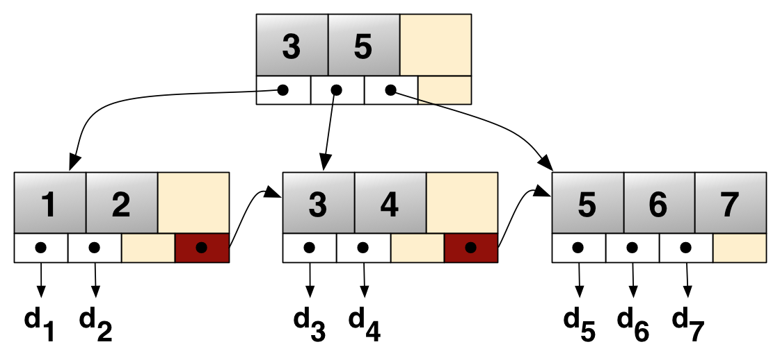
Seeks

Slide 21
Scans

Slide 22
Range Scan

Slide 23
Columnstore Scans
Clustered (CCI) and NonClustered (NCCI) Columnstore Indexes are only ever Scanned (No Seeks) but remain performant because:
Data is Highly Compressed
Larger amount of similar data/patterns when stored in column-wise manner
Utilize Batch Execution Mode
Ability to process up to 900 records per operation instead of row-based per normal
Column Elimination
Only columns referenced in query are accessed
Rowgroup Elimination
Conceptually similar to Partition Elimination in Partitioned Tables
Data must be sorted
NCCI on top of Clustered Table
CCI loaded with MAXDOP=1 (but rebuilds required as order isn’t guaranteed for new data)
https://docs.microsoft.com/en-us/sql/relational-databases/indexes/columnstore-indexes-query-performance
https://blogs.msdn.microsoft.com/sql_server_team/columnstore-index-performance-rowgroup-elimination/

Slide 24
Columnstore Scans (continued)

Slide 25
Unique Constraint/Index
A Unique Constraint automatically creates a corresponding Unique Index
Can be defined on multiple columns
Can have multiple per table
Will allow one NULL (unlike PKEYs where NULLS are not allowed)
Can be referenced by a Foreign Key
https://docs.microsoft.com/en-us/sql/relational-databases/tables/unique-constraints-and-check-constraints

Slide 26
Filtered Indexes
Nonclustered Index which only covers a subset of records within a table
Smaller than a traditional Nonclustered Index
Less Storage
Less Maintenance
Best used on well-defined subsets of data
Use the OPTION (RECOMPILE) hint when writing queries that will touch Filtered Indexes and INCLUDE filtered columns in Index
https://msdn.microsoft.com/en-us/library/cc280372(v=sql.105).aspx
http://sqlblog.com/blogs/rob_farley/archive/2015/02/22/why-isn-t-my-filtered-index-being-used.aspx

Slide 27
Index Design Considerations
FPOC Design
Column Ordering
Bulk Loading Scenarios
Unused (Superfluous) Indexes
Identifying Missing Indexes
When to use Columnstore Indexes
Other Design Considerations

Slide 28
FPOC Design
Term Coined by Itzik Ben-Gan when indexing for Windowing Functions
Useful method to identify which columns to specify within your index
Filter – Columns in the Predicate (e.g. WHERE and ON clauses)
Partition – The Partition Field(s) for any partitioned table
Order – Any Field(s) within the ORDER BY clause
Covering – Any remaining fields within the SELECT clause, not already included
FPO columns comprise your index key
Order by Most to Least Selective if possible
C columns are specified within an INCLUDE clause
http://file.allitebooks.com/20160922/Microsoft%20SQL%20Server%202012%20High%20Performance%20T-SQL%20Using%20Window%20Functions.pdf

Slide 29
Column Ordering
Column ordering in a Query does not matter
Column ordering within an Index Definition does matter
Pick the most selective column first
Selectivity: (Number of Unique Values) / (Number of Records in a Table)
Queries that use the leading fields in the column definition can utilize the index for faster query performance

Slide 30
Column Ordering (continued)
Index A: Index Key - Col01, Col02, Col03
Index B: Index Key - Col02, Col01, Col03
Statement 1: SELECT Col03 FROM Z WHERE Col01 = 1
Statement 2: SELECT Col03 FROM Z WHERE Col02 = 2
Statement 3: SELECT Col03 FROM Z WHERE Col01 = 1 AND Col02 = 2
Statement 4: SELECT Col01 FROM X WHERE Col03 = 3
Statement 1 – Uses Index A
Statement 2 – Uses Index B
Statement 3 – Uses either Index A or Index B (selectivity of leading column will determine which one)
Statement 4 – Will revert to a Table Scan

Slide 31
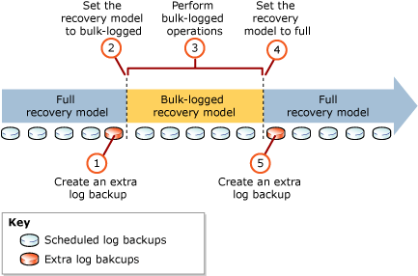
Bulk Loading Scenarios
Indexes are automatically maintained anytime a record is Inserted, Deleted, or Updated
Disable All Nonclustered, Nonunique Indexes prior to load
Rebuild disabled Indexes on Table after data load to re-enable
Generally results in Lower Net Operations
Tipping point depends on percentage of data to import and number of existing indexes, but don’t perform if less than 25% of data is being imported
Potentially Alter DB Recovery Model to Bulk-Logged to further reduce I/O as BULK INSERT is a minimally logged command
Order to switch over
Create TLog Backup
Alter Recovery Model to Bulk-Logged
Perform Bulk Load Operation(s)
Alter Recovery Model to Full
Create TLog Backup
Use TABLOCK hint
https://technet.microsoft.com/en-us/library/ms191244(v=sql.105).aspx https://technet.microsoft.com/en-us/library/ms177445(v=sql.105).aspx

Slide 32
Unused (Superfluous) Indexes
Indexes are automatically maintained anytime a record is Inserted, Deleted, or Updated
Drop/Disable under-utilized Indexes
DMVs
sys.dm_db_index_usage_stats
sys.dm_db_partition_stats
SELECT TableName = OBJECT_SCHEMA_NAME(s.OBJECT_ID, db_id()) + '.' + OBJECT_NAME(s.OBJECT_ID)
, IndexName = i.NAME
, READS = user_seeks + user_scans + user_lookups
, WRITES = user_updates
, p.ROWS
, k.partition_number
, IndexSizeMB = (k.used_page_count * 8) / 1024
FROM sys.dm_db_index_usage_stats s
INNER JOIN sys.indexes i ON i.index_id = s.index_id
AND s.OBJECT_ID = i.OBJECT_ID
INNER JOIN sys.partitions p ON p.index_id = s.index_id
AND s.OBJECT_ID = p.OBJECT_ID
INNER JOIN sys.dm_db_partition_stats k ON k.index_id = i.index_id
AND k.OBJECT_ID = i.OBJECT_ID
WHERE OBJECTPROPERTY(s.OBJECT_ID, 'IsUserTable') = 1
AND s.database_id = DB_ID()
AND i.type_desc = 'nonclustered'
AND i.is_primary_key = 0
AND i.is_unique_constraint = 0
AND p.ROWS > 10000
AND user_seeks + user_scans + user_lookups = 0
ORDER BY READS, WRITES DESC, ROWS DESC

Slide 33
Identifying Missing Indexes
Review Queries Actively in Cache
Review Queries that are hitting the largest Objects in Cache
What Indexes can be extended to cover more queries?
Run through these exercises at different times of the day/month/business cycle

Slide 34
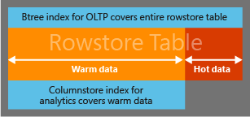
When to use Columnstore Indexes
Table has more than 1 million records (ideally many more)
Use Clustered Columnstore Indexes (CCI) on Star/Snowflake Schemas as an alternative to SSAS cubes
Use NonClustered Columnstore Indexes (NCCI) on Tables that support transactional workloads but also require Real-Time analytics
Use Filtered NCCIs for Warm Transactional Data to minimize maintenance needs
Ensure SET Options are configured properly
https://docs.microsoft.com/en-us/sql/relational-databases/indexes/columnstore-indexes-data-warehouse https://docs.microsoft.com/en-us/sql/relational-databases/indexes/get-started-with-columnstore-for-real-time-operational-analytics https://docs.microsoft.com/en-us/sql/t-sql/statements/create-columnstore-index-transact-sql

Slide 35
When to use Columnstore Indexes (continued)
Use COMPRESSION_DELAY to minimize NCCI fragmentation for tables with heavy DML operations (e.g. UPDATE/DELETE/INSERT)
Can specify a value up to 7 days (i.e. 10,080 minutes)
Offload Analytical Queries against NCCI/CCI columns to Read-Only secondary if using AGs and running Enterprise Edition
Use empty (filtered) NCCIs to allow Rowstore Indexes to take advantage of Batch-Execution mode (rarely will be needed)
Frameless Aggregate Window Functions, such as: SELECT actid, tranid, val, SUM(val) OVER(PARTITION BY actid) AS acttotal FROM dbo.TransactionsDCS;
Improve Query Permformance against Entity-Attribute-Value Data Model
https://blogs.msdn.microsoft.com/sqlserverstorageengine/2016/03/06/real-time-operational-analytics-compression-delay-option-for-nonclustered-columnstore-index-ncci/ http://sqlmag.com/sql-server/what-you-need-know-about-batch-mode-window-aggregate-operator-sql-server-2016-part-1

Slide 36
Other Design Considerations
Enterprise Edition Considerations if not running SQL 2016 SP1 or later
Utilize Page or Row compression in larger tables
Take advantage of In-Memory Tables
Run complex queries through the Database Tuning Advisor
Test out Missing Index recommendations that are displayed within execution plan (SET SHOWPLAN_XML ON)
https://blogs.msdn.microsoft.com/sqlreleaseservices/sql-server-2016-service-pack-1-sp1-released/

Slide 37
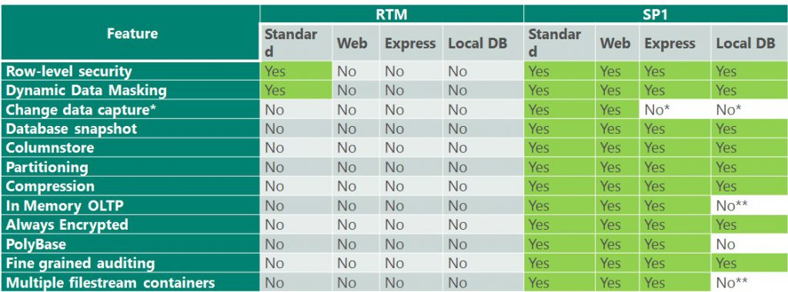
Upgrade to SQL Server 2016 SP1
https://blogs.msdn.microsoft.com/sqlreleaseservices/sql-server-2016-service-pack-1-sp1-released/

Slide 38
Index Misconceptions
Helpful Tools to Identify Missing Indexes
Index/Table Padding (Whitespace)
Index Fragmentation
Self-Managing Statistics
DBCC CHECKDB using REPAIR_ALLOW_DATA_LOSS
Columnstore Indexes

Slide 39
Misconception – Helpful Tools to Identify Missing Indexes
Profiler Traces/Extended Events
This information already exists in cache or the Query Store
Requires additional overhead for existing functionality
Missing Index DMVs (sys.dm_db_missing_index_details)
Often poor recommendations
Will recommend nearly-duplicate index definitions
No way to identify why the recommendation is made
improvement_measure field is arbitrary and does not indicate saved CPU cycles, reduced I/O, etc.
Instead: Identify Missing Indexes by the methods described earlier

Slide 40
Misconception – Index/Table Padding (Whitespace)
FILLFACTOR keyword in Index Definition
Represents the Percentage each Leaf-Level Page will be filled to when creating a new page or rebuilding the index
Actually Makes Indexes and Tables Larger on Disk and Memory
Often set in an attempt to minimize Index/Table Fragmentation
Provides no value for Tables that append data to the end of the table (e.g. PKEY is defined on an IDENTITY field)
Instead: Don’t specify FILLFACTOR, leave it at the default setting of 0
https://docs.microsoft.com/en-us/sql/relational-databases/indexes/specify-fill-factor-for-an-index

Slide 41
Misconception – Index Fragmentation
Fragmentation exists when indexes have pages where the logical ordering, based on the key value, does not match the physical ordering inside the data file
Low Fragmentation does not represent data being stored contiguously on disk, only in a sequential order
Disk Subsystems may purposely fragment the data on disk for redundancy purposes (e.g. RAIDed volumes, SANs, DAS)
May only be of any concern with Locally managed disk
Fragmented Indexes perform the same once in Memory as their Defragmented counterparts
https://docs.microsoft.com/en-us/sql/relational-databases/indexes/reorganize-and-rebuild-indexes

Slide 42
Misconception – Index Fragmentation (continued)
Will cause more read-aheads when pulling pages from disk
Read-ahead anticipates the data and index pages needed to fulfill a query execution plan and brings the pages into the buffer cache before they are actually used by the query.
Will become less costly as the index stays in memory longer
Rebuilding/Reorganizing of large or multiple Indexes can quickly purge your cache
Instead: Rebuild Indexes based on average freespace per page for the 0-level of the index (avg_page_space_used_in_percent column in sys.dm_db_index_physical_stats) as a Rebuild/Reorg is the only way to reduce whitespace within an index
Must use sys.dm_db_index_physical_stats using either DEFAULT, SAMPLED, or FULL scan level
https://technet.microsoft.com/en-us/library/ms191475(v=sql.105).aspx https://docs.microsoft.com/en-us/sql/relational-databases/system-dynamic-management-views/sys-dm-db-index-physical-stats-transact-sql

Slide 43
Misconception - Self-Managing Statistics
When Auto-Update Statistics is enabled, stats only auto-update when at least 500 records plus another 20% of records within a table are changed
The 20% requirement does not change as a table grows in size by default
Instead: Update Statistics manually and frequently (based on modification_counter field in sys.dm_db_stats_properties DMV).
Instead: Enable Trace flag 2371 on SQL Server 2014 and earlier (automatically enabled in SQL Server 2016). This flag reduces the 20% threshold as the table record count increases.
https://msdn.microsoft.com/en-us/library/jj553546.aspx
https://support.microsoft.com/en-us/help/2754171/controlling-autostat-auto-update-statistics-behavior-in-sql-server https://www.simple-talk.com/sql/performance/sql-server-statistics-questions-we-were-too-shy-to-ask

Slide 44
Misconception - DBCC CHECKDB using REPAIR_ALLOW_DATA_LOSS
The REPAIR_ALLOW_DATA_LOSS functionality is lazy. If direct paths to the data do not exist, this option drops pointers to the data and allows garbage collection to purge the data
This option can and likely will break Referential Integrity within a database
Instead: If a Nonclustered Index is corrupted, Drop/Recreate or Rebuild it
Instead: If a Clustered Index or Heap Table is corrupted, access the data via a Nonclustered Index and write the data out to a separate table

Slide 45
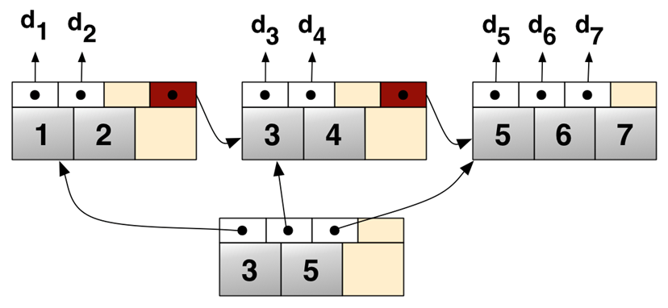
Clustered Index
Nonclustered Index

Slide 46
Misconception - Columnstore Indexes
Columnstore Indexes are finally fully fledged as of SQL 2016
2014 – Beta Release
2012 – Alpha Release
Check Dates on Blog Posts regarding Columnstore Indexes
Articles written in Q3 of 2016 and later are likely safe
Reorganize operations should be ran twice, when ran in general
First to compress rows into the rowstore
ALTER INDEX CCI_name ON Table REORGANIZE WITH (COMPRESS_ALL_ROW_GROUPS = ON)
Second to combine small rowstores together
ALTER INDEX CCI_name ON Table REORGANIZE
Use sys.dm_db_column_store_row_group_physical_stats DMV to monitor
No longer an Enterprise Only Feature (SQL 2016 SP1 and later)
https://docs.microsoft.com/en-us/sql/relational-databases/indexes/columnstore-indexes-defragmentation https://blogs.msdn.microsoft.com/sqlserverstorageengine/2016/03/07/columnstore-index-defragmentation-using-reorganize-command/

Slide 47
Supplemental Queries
Cache Used by DB
Author: Aaron Bertrand
Cache Used by Index within DB
Author: Aaron Bertrand
Cached Queries Using Table/View
Most Costly Queries in Cache
https://www.mssqltips.com/sqlservertip/2393/determine-sql-server-memory-use-by-database-and-object/

Slide 48
Cache Used by DB
DECLARE @total_buffer INT;
SELECT @total_buffer = cntr_value
FROM sys.dm_os_performance_counters
WHERE RTRIM([object_name]) LIKE '%Buffer Manager'
AND counter_name IN ('Total Pages', 'Database Pages');
;WITH src AS
(
SELECT
database_id, db_buffer_pages = COUNT_BIG(*)
FROM sys.dm_os_buffer_descriptors
GROUP BY database_id
)
SELECT
[db_name] = CASE [database_id] WHEN 32767
THEN 'Resource DB'
ELSE DB_NAME([database_id]) END,
db_buffer_pages,
db_buffer_MB = db_buffer_pages / 128,
db_buffer_percent = CONVERT(DECIMAL(6,3),
db_buffer_pages * 100.0 / @total_buffer)
FROM src
ORDER BY db_buffer_MB DESC;

Slide 49
Cache Used by Index within DB
USE [DB_Name];
GO
;WITH src AS
(
SELECT
[Object] = o.name,
[Type] = o.type_desc,
[Index] = COALESCE(i.name, ''),
[Index_Type] = i.type_desc,
p.[object_id],
p.index_id,
au.allocation_unit_id
FROM
sys.partitions AS p
INNER JOIN
sys.allocation_units AS au
ON p.hobt_id = au.container_id
INNER JOIN
sys.objects AS o
ON p.[object_id] = o.[object_id]
INNER JOIN
sys.indexes AS i
ON o.[object_id] = i.[object_id]
AND p.index_id = i.index_id
WHERE
au.[type] IN (1,2,3)
AND o.is_ms_shipped = 0
)
SELECT
src.[Object],
src.[Type],
src.[Index],
src.Index_Type,
buffer_pages = COUNT_BIG(b.page_id),
buffer_mb = COUNT_BIG(b.page_id) / 128
FROM
src
INNER JOIN
sys.dm_os_buffer_descriptors AS b
ON src.allocation_unit_id = b.allocation_unit_id
WHERE
b.database_id = DB_ID()
GROUP BY
src.[Object],
src.[Type],
src.[Index],
src.Index_Type
ORDER BY
1, buffer_pages DESC;

Slide 50
Cached Queries Using Table/View
SELECT DISTINCT TOP 100
s.total_logical_reads/s.execution_count AS UsageScore,
SUBSTRING(t .text, (s.statement_start_offset/ 2)+1 ,
((CASE s.statement_end_offset
WHEN - 1 THEN DATALENGTH(t.text)
ELSE s.statement_end_offset
END - s.statement_start_offset )/2) + 1 ) AS statement_text,
s.execution_count AS ExecutionCount,
s.max_elapsed_time AS MaxElapsedTime,
ISNULL(s.total_elapsed_time / s.execution_count, 0) AS AvgElapsedTime,
s.creation_time AS LogCreatedOn,
*
FROM sys.dm_exec_query_stats s CROSS APPLY sys.dm_exec_sql_text( s.sql_handle ) t
WHERE text like '%ObjectName%' -- Enter Table/View name here
and text not like '%sys.dm_exec_query_stats s%'
ORDER BY s.total_logical_reads/s.execution_count DESC
/*
-- Pull Execution Plan
SELECT query_plan
FROM sys.dm_exec_query_plan(plan_handle_from_results)
*/

Slide 51
Most Costly Queries in Cache
SELECT TOP 100
SUBSTRING(t.text, (s .statement_start_offset/ 2)+1 ,
((CASE s.statement_end_offset
WHEN - 1 THEN DATALENGTH(t.text)
ELSE s.statement_end_offset
END - s.statement_start_offset )/2) + 1 ) AS statement_text
, DB_NAME (t.dbid) AS [db_name]
, 1.00* s.total_elapsed_time / DATEDIFF (second, s.creation_time, GETDATE ()) / 1 AS percent_used_time
, DATEDIFF (HOUR, s.creation_time, GETDATE()) AS cached_hours
, s.execution_count
, 1.00* s.execution_count / ( 1+DATEDIFF (HOUR, s.creation_time, GETDATE())) AS executions_per_hour
, s.max_elapsed_time
, ISNULL (s.total_elapsed_time / s.execution_count, 0) AS avg_elapsed_time
, s.total_elapsed_time
, s.creation_time
, s.last_execution_time
, s.sql_handle
, s.plan_handle
, c.most_recent_session_id
, c.parent_connection_id
, c.session_id
FROM sys .dm_exec_query_stats s
CROSS APPLY sys. dm_exec_sql_text( s .sql_handle ) t
LEFT JOIN sys. dm_exec_connections c
ON c. most_recent_sql_handle = s .sql_handle
WHERE s. execution_count > 1 AND DATEDIFF (second, creation_time,GETDATE ())>0
ORDER BY 9 DESC --total_elapsed_time
/*
-- Pull Execution Plan
SELECT query_plan
FROM sys.dm_exec_query_plan(s.plan_handle)
*/

Slide 52
Additional Resources
Stack Exchange: http://dba.stackexchange.com/
Lazy SQL Server DBA Google Group: https://groups.google.com/forum/#!forum/lazy-sql-server-dbas
Slack: https://sqlcommunity.slack.com/
Technet Forums: https://social.technet.microsoft.com/Forums
MS Connect: https://connect.microsoft.com/
Twitter Hashtag: #sqlhelp

Slide 53
Questions?

